Slide 1
CLASS SECTION : IE5303-001 QUALITY SYSTEMS
PROJECT PROBLEM STATEMENT
INDUSTRY : MANUFACTURING FACILITY (AUTOMOBILE/ELECTRONICS)
PROBLEM STATEMENT:
Based on inspection results, PH-beauty Co, has experienced an issue with lipstick melting during transportation due to insufficient heat resistance in the packaging. Currently, the rejection rate us 5%. Our target is to reduce to 1%
Pooja Govinda Reddy 1002167429

Slide 2
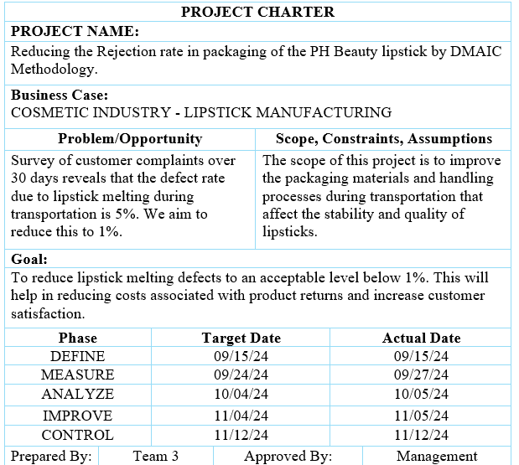
DEFINE

Slide 3
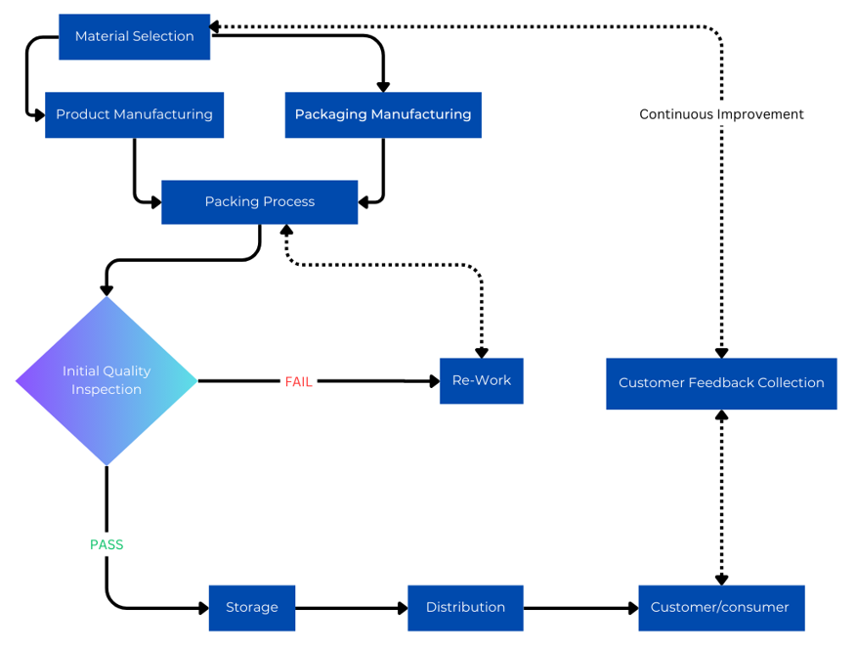
PROCESS MAP

Slide 4
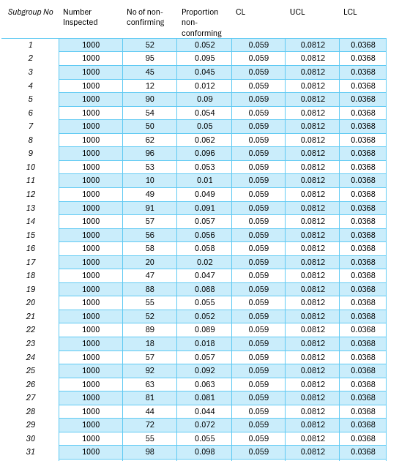
MEASURE VALIDATE DATA ACCURACY

Slide 5
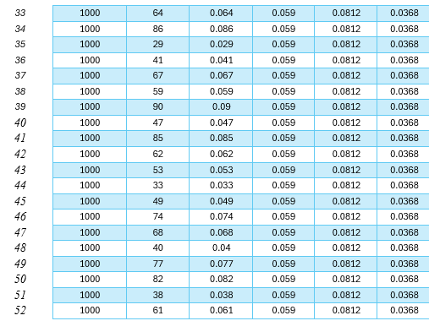

Slide 6
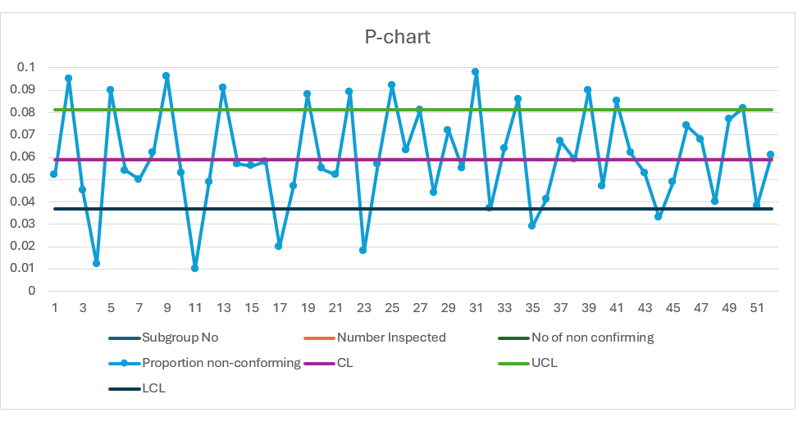
MEASURE VALIDATE DATA ACCURACY

Slide 7
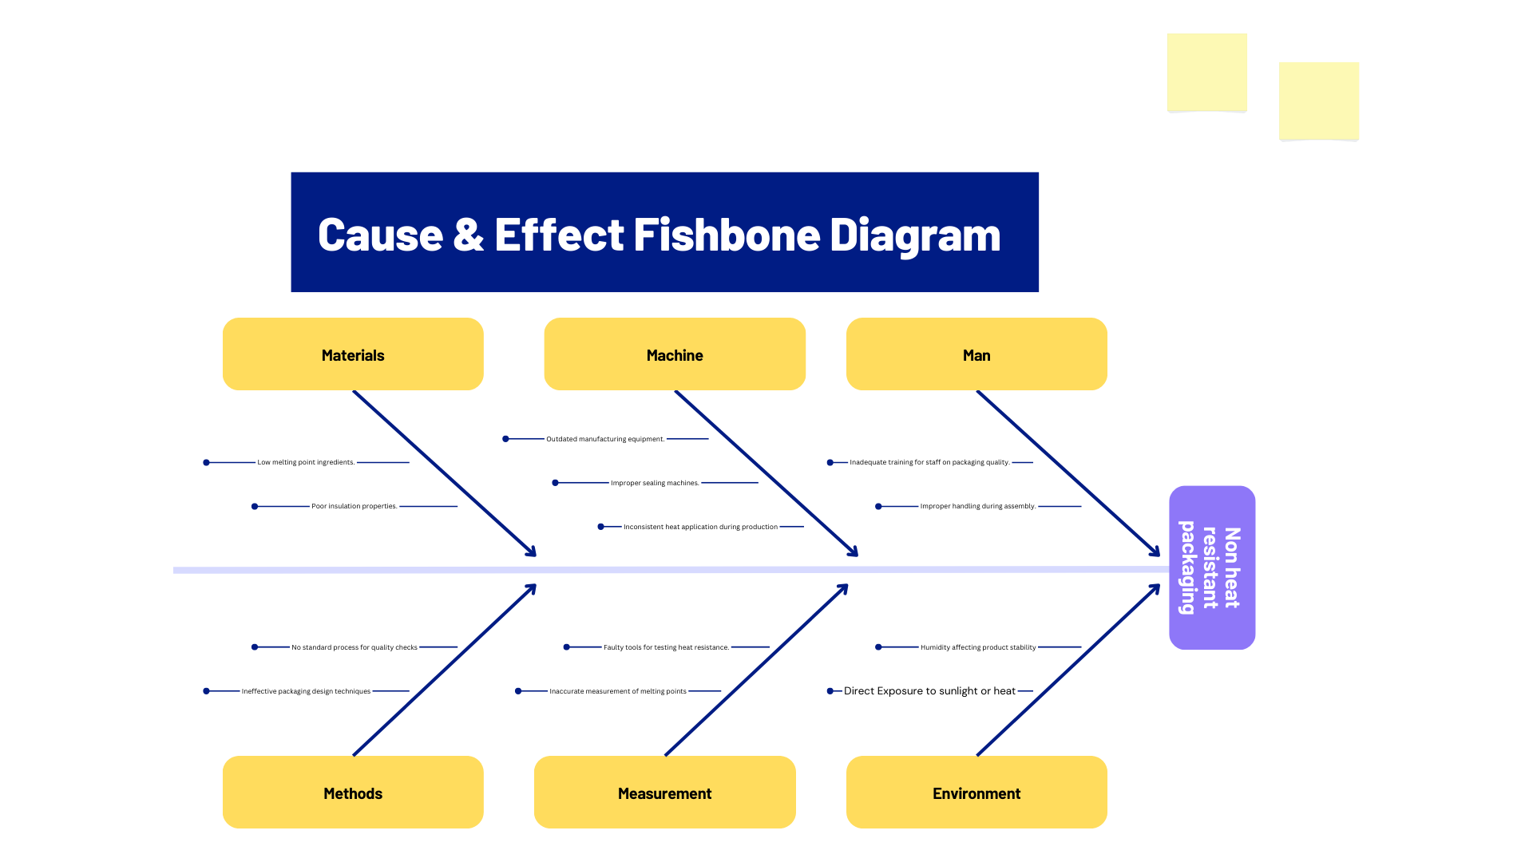
ANALYSE CAUSE INVESTIGATION

Slide 8
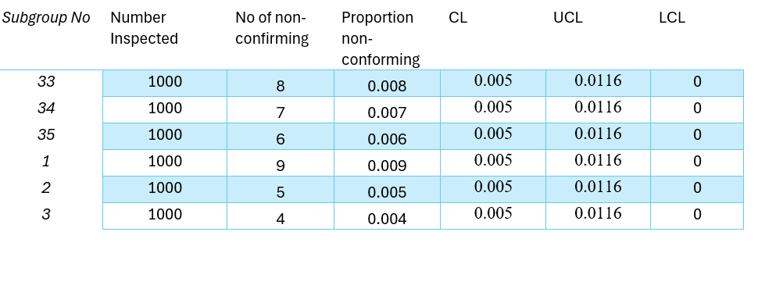
IMPROVE OPTIMAL SOLUTION

Slide 9
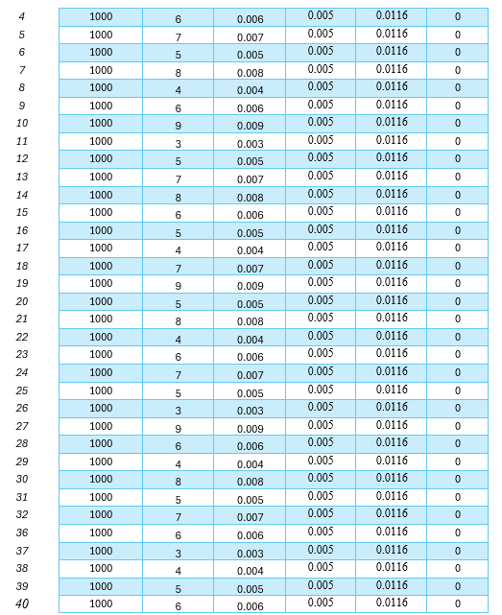

Slide 10
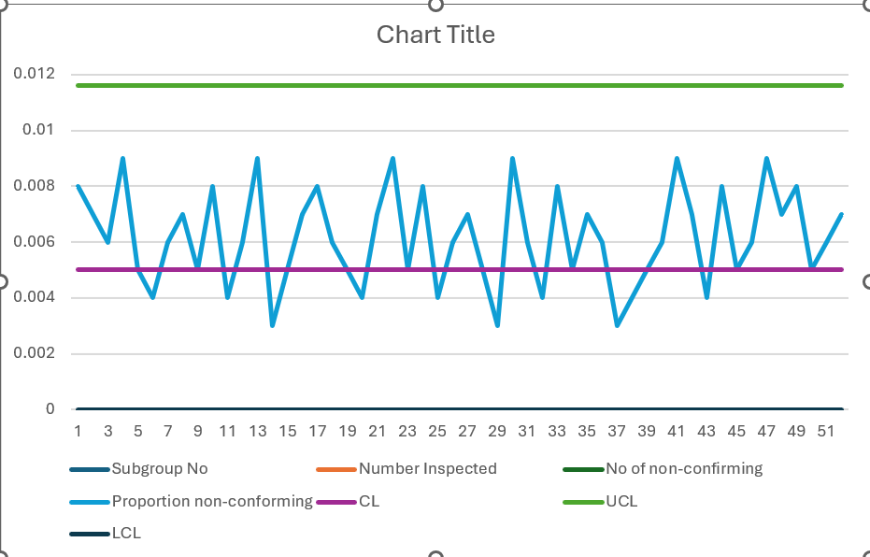
IMPROVE PILOT TESTING

Slide 11
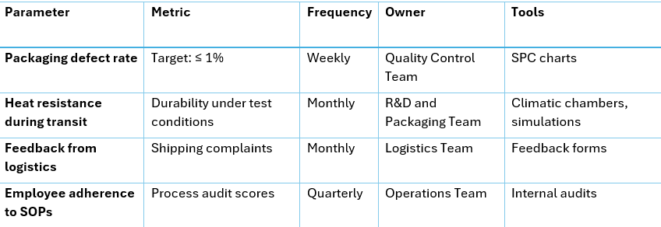
CONTROL STANDARDIZE SOLUTION

Slide 12
THANK YOU

